Slide 1

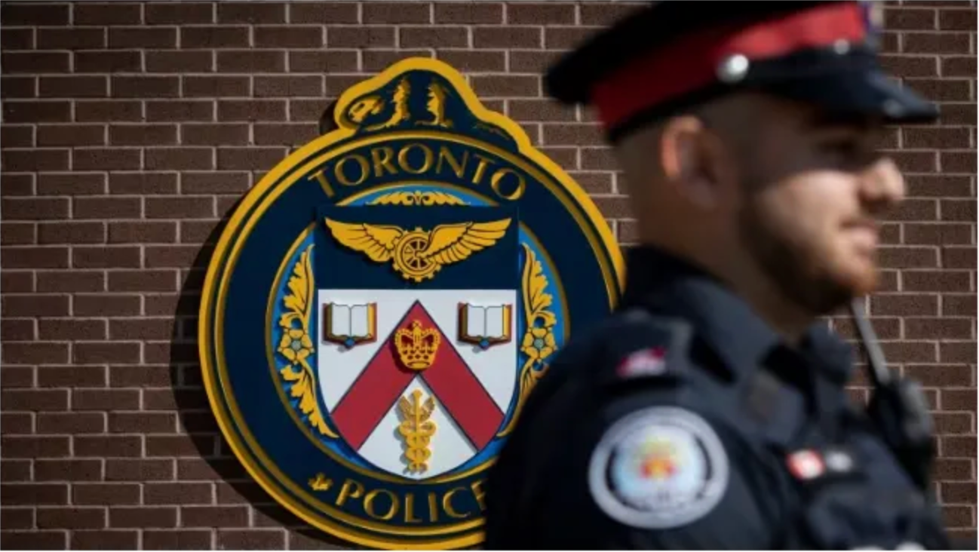




Analysis of Crime Patterns in Toronto
A Data Mining Approach to Public Safety (2014-2025)
Presented to : Director of Toronto Police
Analytics and the City Planning
Committee
1
Notes:
Photo by Sean Pollock on Unsplash
1

Slide 2

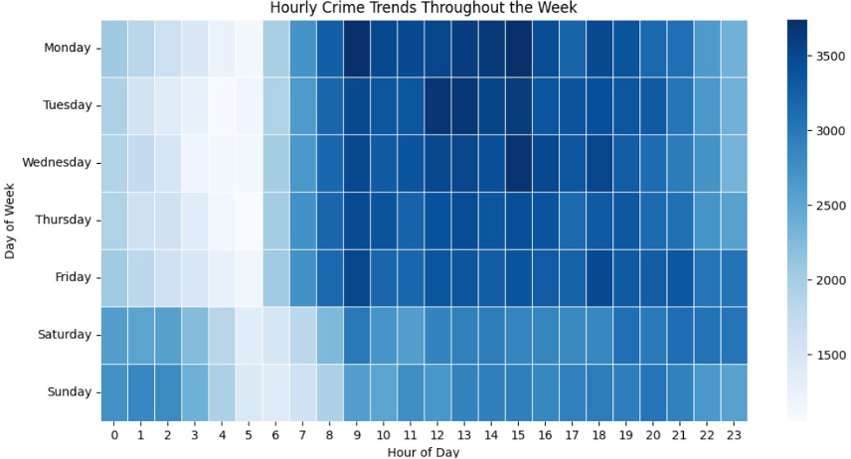
Problem Definition & Related Work
Problem Statement
Crime in Toronto follows hidden spatial and temporal patterns. Detecting these trends can help prevent incidents, optimize policing, and inform data-driven city planning.
Why is it interesting?
Resource Allocation: Police cannot be everywhere at once.
Urban Planning: Designing safer neighborhoods requires data, not intuition.
Real Data, Real Stakes: Unlike textbook problems, this data directly affects public safety and community well-being.
Quick overview of what others have done
A few projects tried using basic machine learning to predict crime types.
People have analyzed crime locations and times to find trends.
Earlier work mostly focused on simple statistics rather than advanced models.
2
Notes:
3

Slide 3
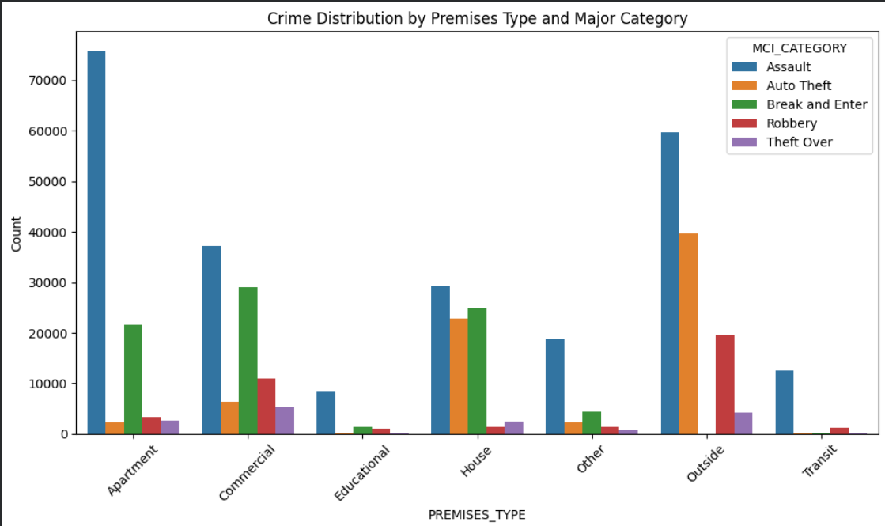
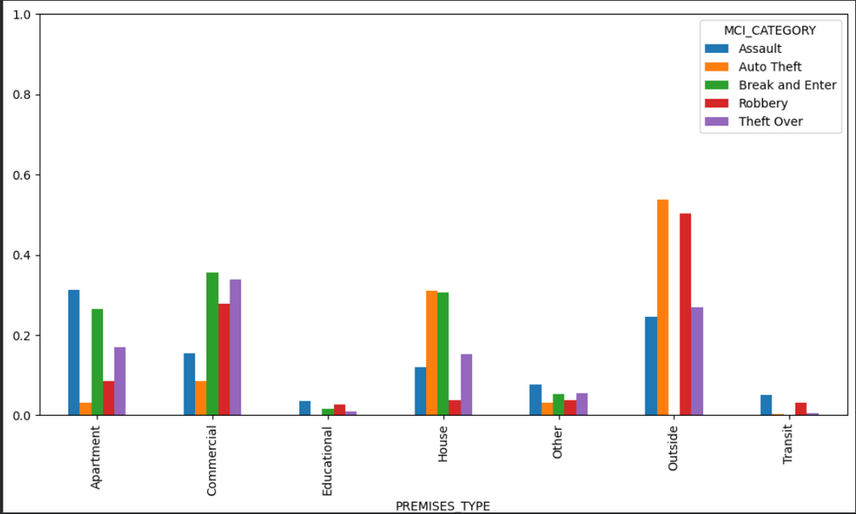
Problem Definition & Related Work
3
Notes:
3

Slide 4
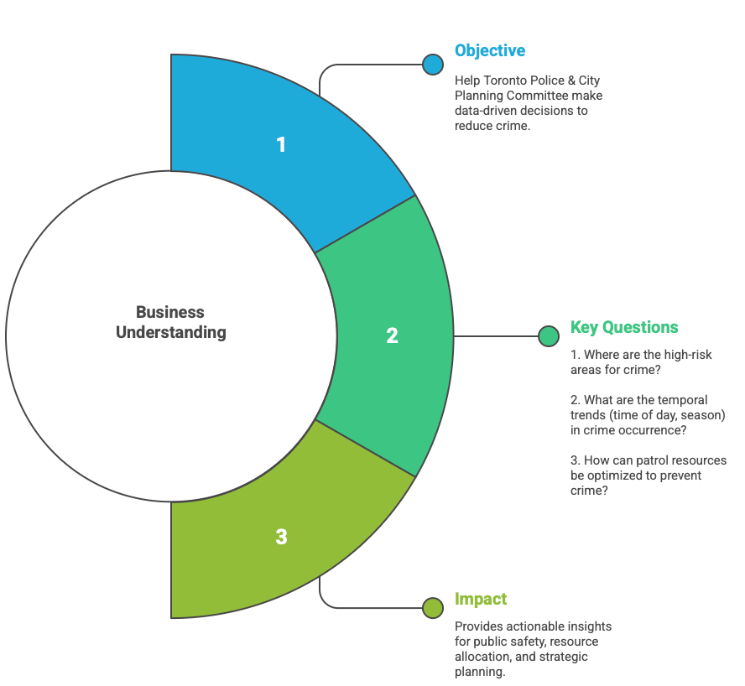
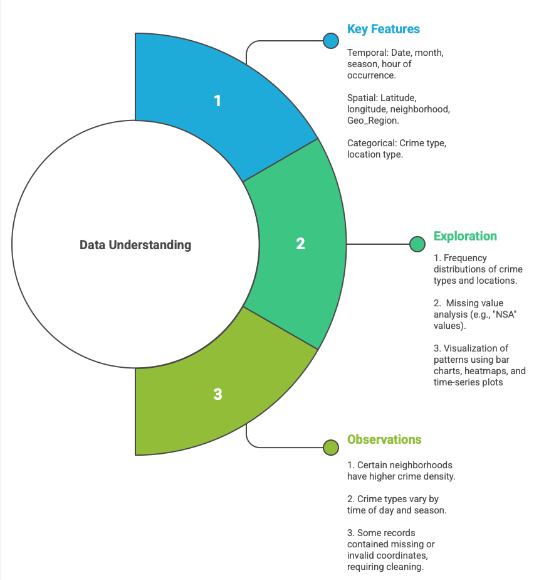
BUSINESS AND DATA UNDERSTANDING
4

Slide 5
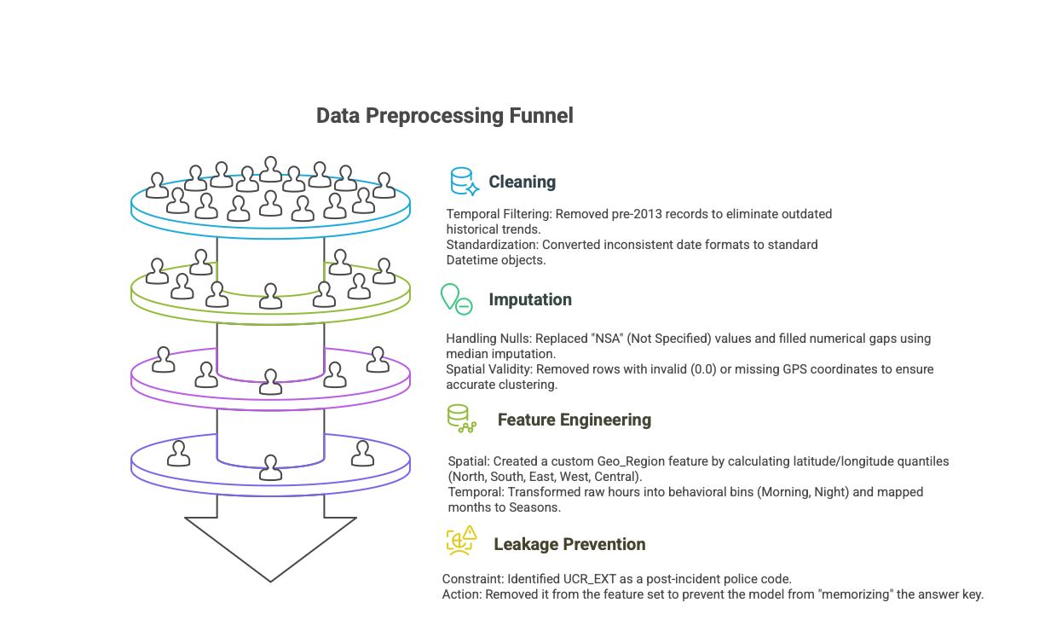
What Have we Done?
5
Notes:
4

Slide 6
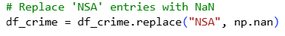
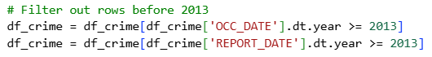
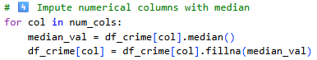
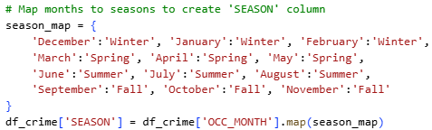
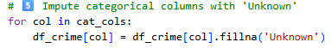
Data Preparation
6
Notes:
4

Slide 7

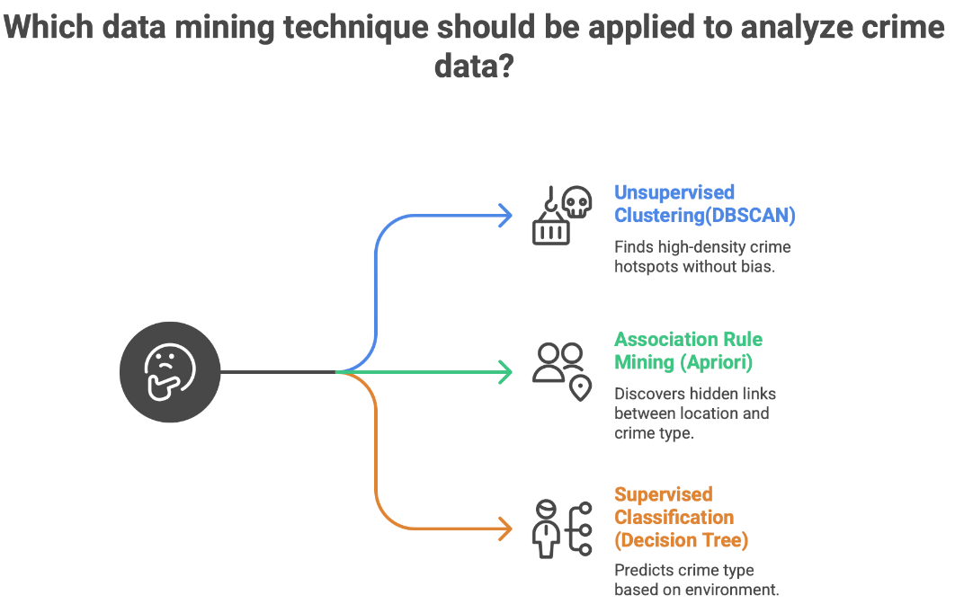
7
6
Notes:
2

Slide 8
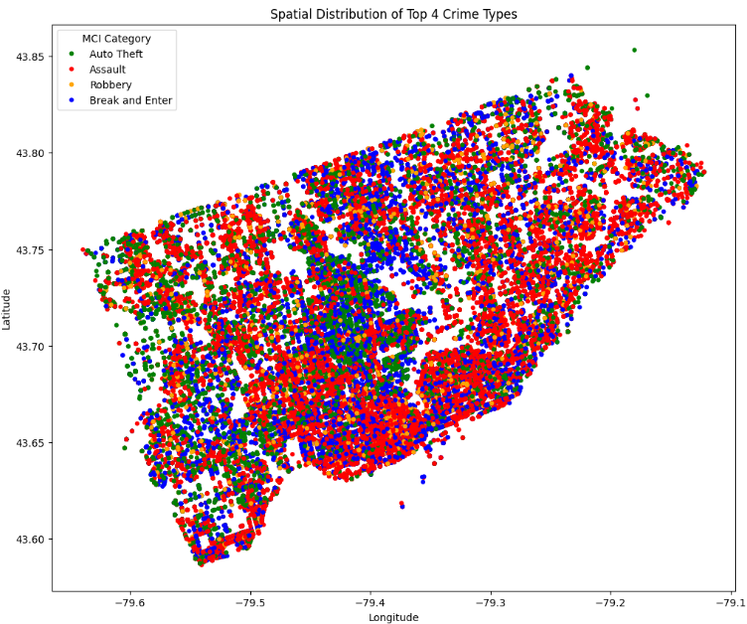
Spatial Clustering: Identifying The City’s "Risk Skeleton"
Successfully separated the city into core high-density clusters and low-density "noise" areas (the unclustered points).
The spatial distribution of Assaults (Red) strongly aligns with the dense DBSCAN clusters, indicating these crimes are tied to high population-dense areas (e.g., Downtown, transit hubs).
Using an epsilon of 0.25 aggregates smaller neighborhood hotspots into larger macro-regions, highlighting broad districts that require systemic police presence.
8

Slide 9
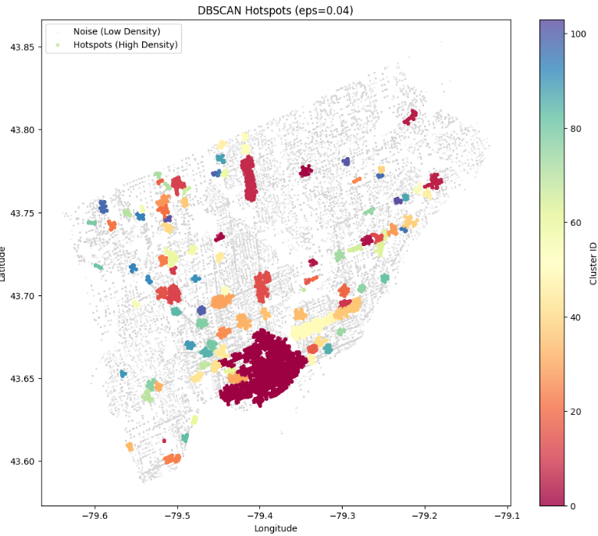
Granular Analysis: Isolating High-Density "Micro-Hotspots"
Tuned DBSCAN parameters to a tighter radius (eps=0.04) to break broad zones into specific, actionable locations.
Grey Points: Represent low-density "background noise" (isolated crimes).
Colored Clusters: Represent high-density micro-hotspots (specific intersections, malls, or transit stations).
9

Slide 10
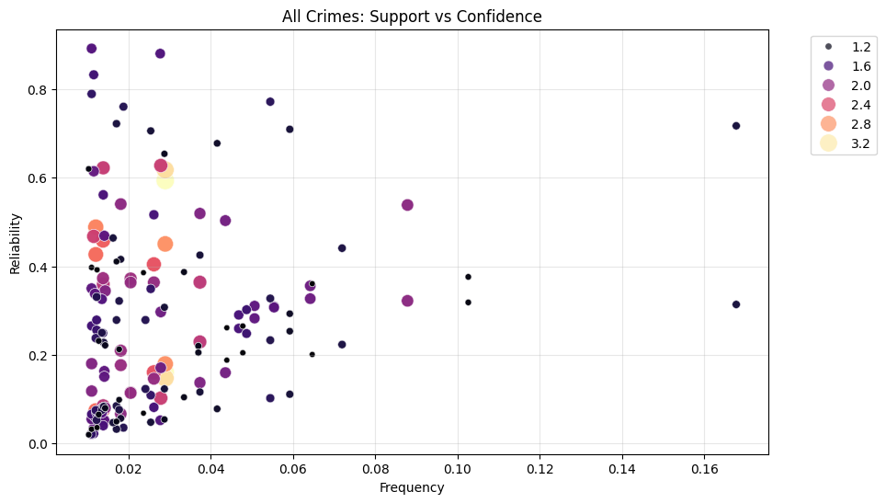




Association Rules Scatter Plot: Support vs. Confidence (Coloured by Lift)
Rare crime scenarios often show high confidence, making them highly predictable targets.
High lift scores reveal strong associations 2-3x more likely than random chance.
The model effectively filters out random incidents to highlight systematic patterns.
19
10

Slide 11
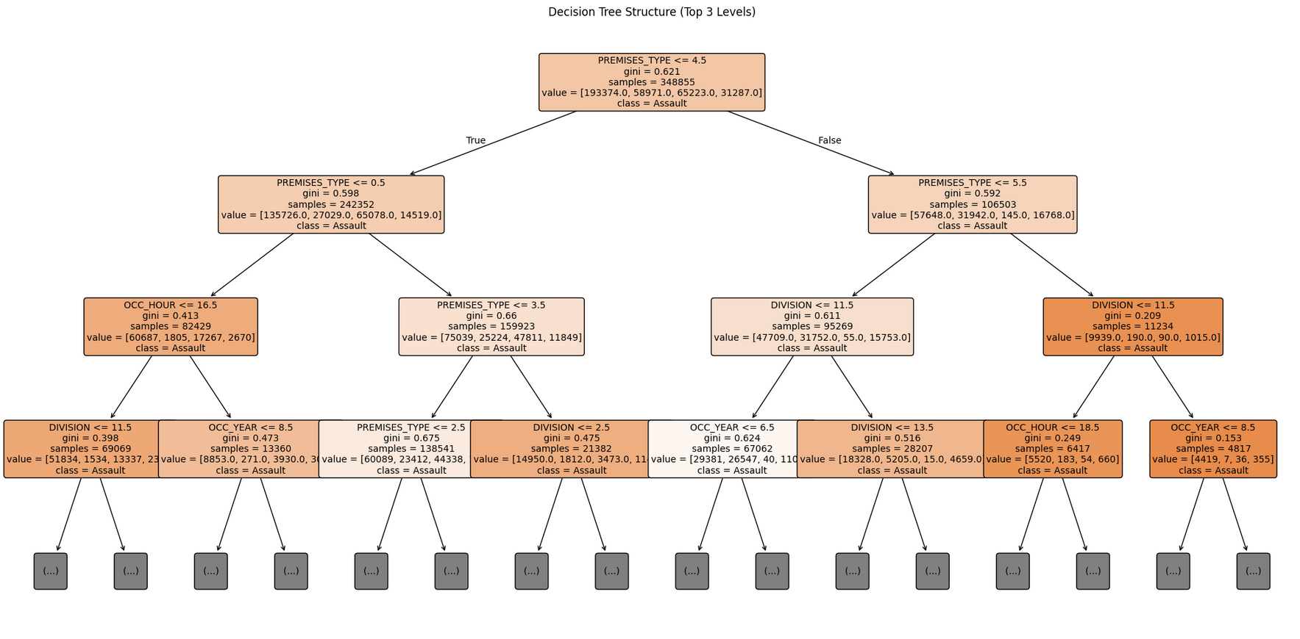
Decision Tree
The model correctly identified over 42,000 Assaults, ensuring the city’s most frequent violent risk is rarely missed.
Prioritized violent crime detection, achieving a remarkable 88% Recall rate for Assaults.
The model identified "Premises Type" as the single strongest predictor of crime, outranking time or location.
11
19

Slide 12
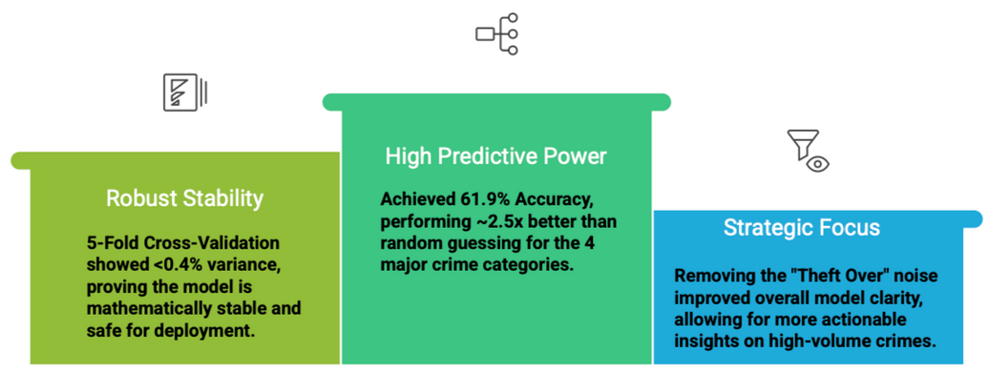
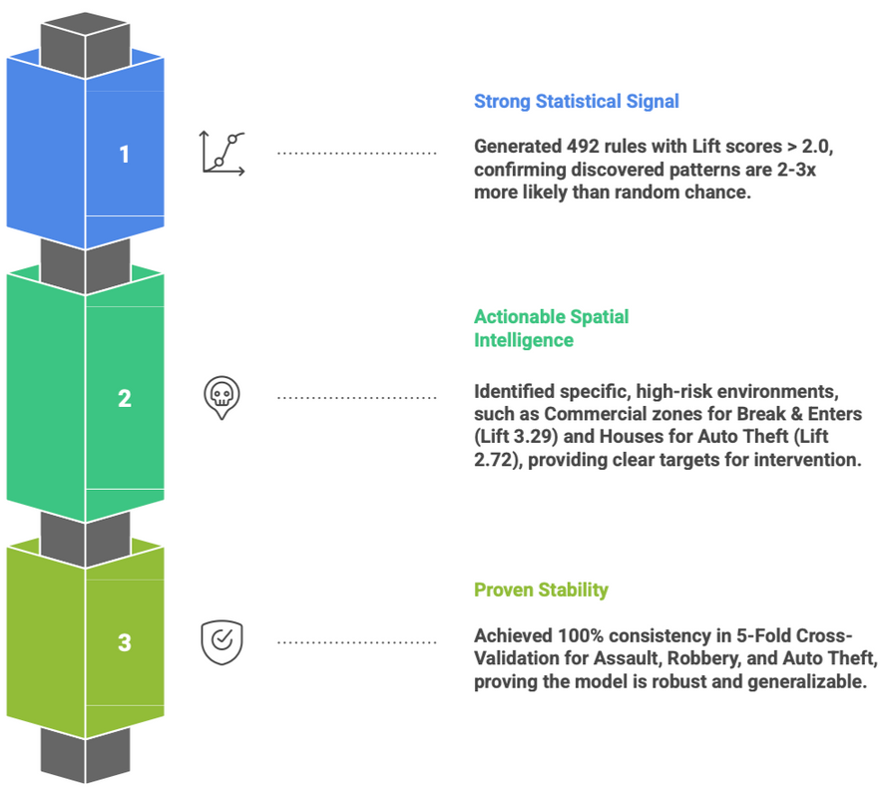
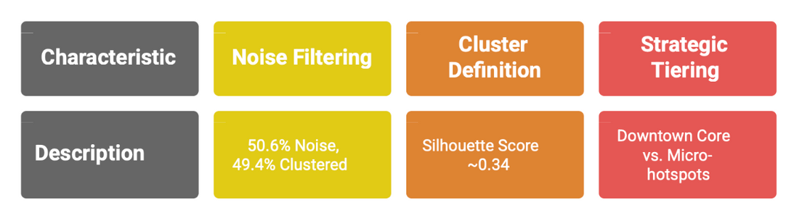
Model Evaluation & Performance
Decision Tree
Apriori Algorithm
DBSCAN
12
Notes:
5

Slide 13
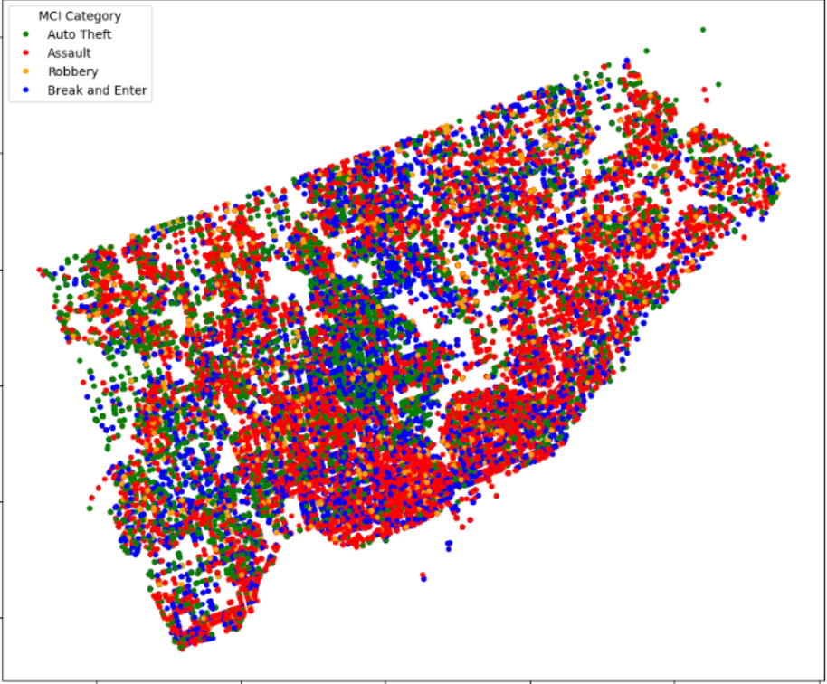
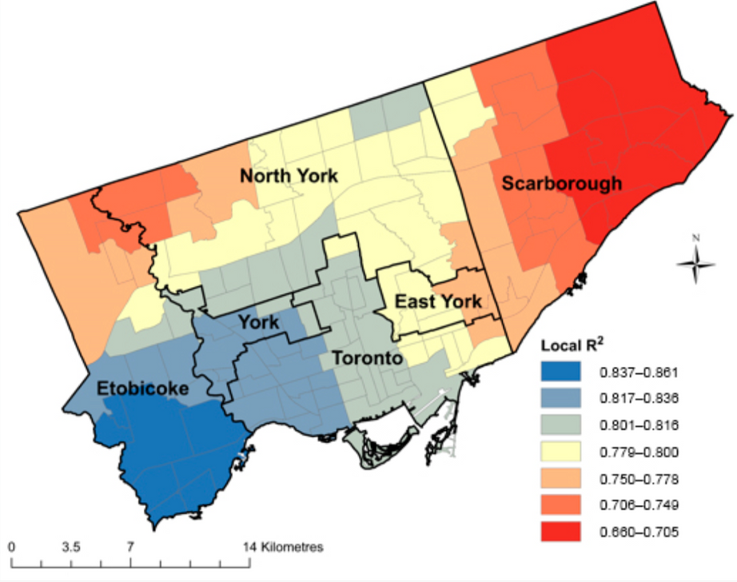
Interesting Aspects of the Implementation
Actual Map
Our Urban Skelton Map
Visualizing the raw spatial distribution of multiple crime categories reveals a high-density environment with significant geographic overlap across the region.
Interestingly, this density provides immediate visual validation of the underlying model data. It confirms that the raw coordinates accurately map to real-world geography (streets and boundaries) even before complex processing is applied.
13

Slide 14
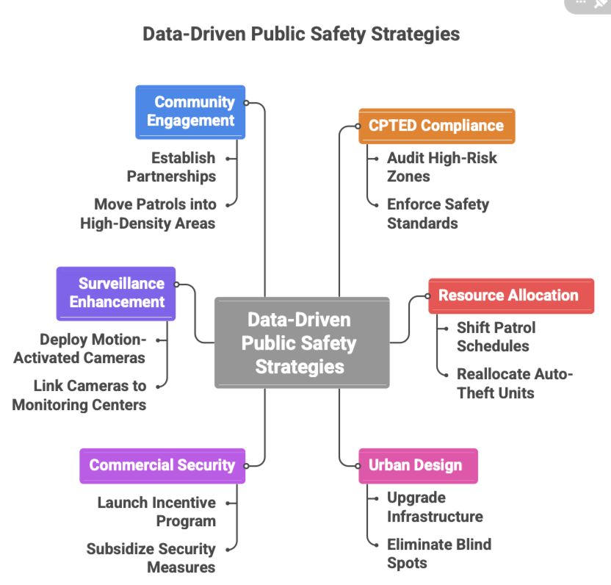
From Insight to Action: Data-Driven Public Safety Strategies
14
Notes:
9

Slide 15
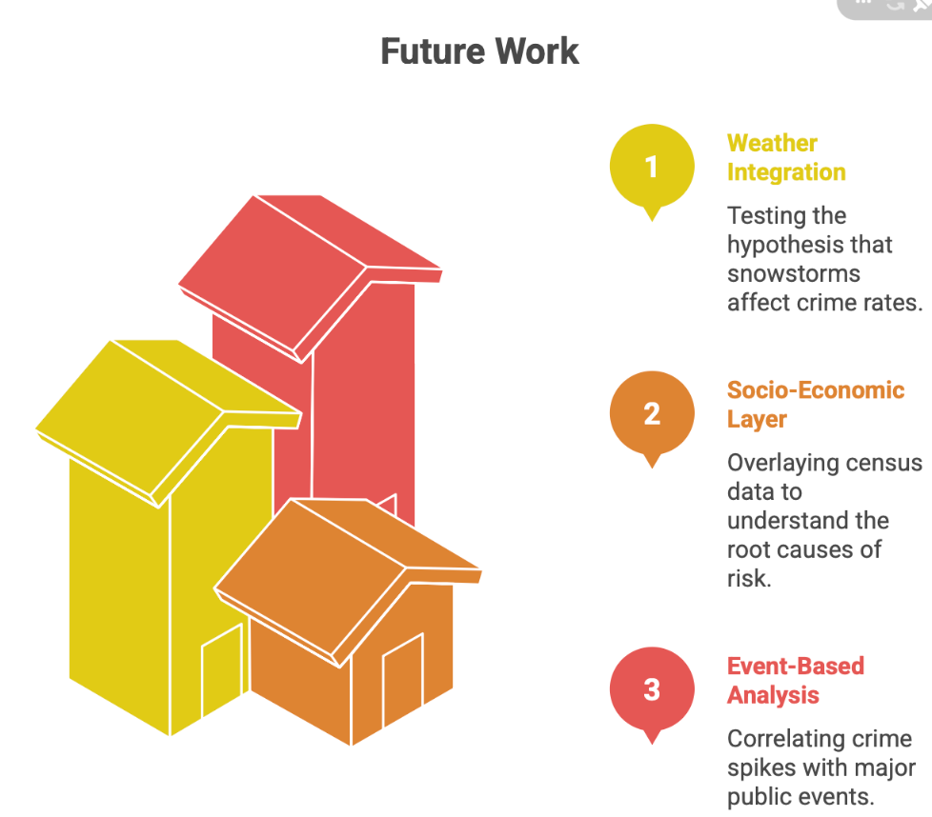
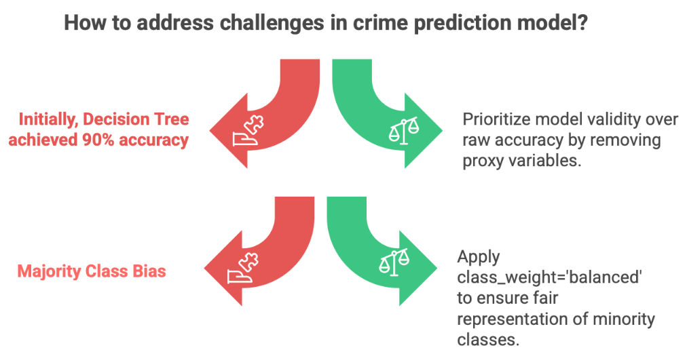
Critical Reflection And the Path Forward
15

Slide 16
References
Hypothesis Testing
Data Source
[1] Toronto Police Service, "Major Crime Indicators (MCI) 2014-2024," Public Safety Data Portal, 2025. [Online]. Available: https://data.torontopolice.on.ca/pages/major-crime-indicators. [Accessed: Nov. 24, 2025]
Methodology (CRISP-DM)
[2] R. Wirth and J. Hipp, "CRISP-DM: Towards a standard process model for data mining," in Proc. 4th Int. Conf. Pract. Appl. Knowl. Discov. Data Min., Manchester, U.K., 2000, pp. 29–39. [Online]. Available: http://cs.unibo.it/~danilo.montesi/CBD/Beatriz/10.1.1.198.5133.pdf.
Algorithms & Theoretical Foundations
[3] (DBSCAN) M. Ester, H.-P. Kriegel, J. Sander, and X. Xu, "A density-based algorithm for discovering clusters in large spatial databases with noise," in Proc. 2nd Int. Conf. Knowl. Discov. Data Min. (KDD-96), Portland, OR, 1996, pp. 226–231. [Online]. Available: https://file.biolab.si/papers/1996-DBSCAN-KDD.pdf
[4] (Apriori) R. Agrawal and R. Srikant, "Fast algorithms for mining association rules," in Proc. 20th Int. Conf. Very Large Data Bases (VLDB), Santiago, Chile, 1994, pp. 487–499. [Online]. Available: https://snap.stanford.edu/class/cs224w-readings/Agrawal94AssosiationRule.pdf
[5] (Decision Trees/CART) L. Breiman, J. H. Friedman, R. A. Olshen, and C. J. Stone, Classification and Regression Trees. Belmont, CA: Wadsworth, 1984.[Online]. Available:https://www.researchgate.net/profile/Dan-Steinberg/publication/265031802_Chapter_10_CART_Classification_and_Regression_Trees/links/567dcf8408ae051f9ae493fe/Chapter-10-CART-Classification-and-Regression-Trees.pdf
16
Notes:
24

Slide 17

THANK YOU
17

